Slide 1

CHRISTIAN NII COMMEY SOLOMON - 04091851 JEREMY EDUDZI AVADZI - 4121210061
DESIGN AND DEVELOPMENT OF AN ENHANCED E-LEARNING PLATFORM FOR AN INTERACTIVE EDUCATIONAL EXPERIENCE
GHANA COMMUNICATION TECHNOLOGY UNIVERSITY

Slide 2
PROBLEM STATEMENT
According to the Ghana Journal of Higher Education, traditional mode of delivery has been predominant but is facing challenges in adapting to the evolving educational landscape of the 21st century.
Ernest Adu Gyamfi and Paul Kwadwo Addo (2020), argue that the traditional mode of delivery has not kept pace with the changing trends in higher education and has failed to provide adequate access to education, particularly in remote regions.
resulting in a gap between the effectiveness of online learning compared to traditional methods.
This begs the need for a well-crafted e-learning platform that bridges this gap.

Slide 3
OBJECTIVE OF STUDY
The primary objective of this study is to develop an interactive e-learning platform
The specific objectives of the study include:
Implementing a comprehensive indexing algorithm for centralized educational resource repository.
Ensuring compatibility across different devices and platforms.
Optimizing bandwidth usage to accommodate a large number of simultaneous users without compromising performance

Slide 4
Reference | Authors | Summary | Year
[1] | ( Islam, Beer & Slack ) | Highlight that, while current platforms aim to simplify existing educational paradigms for online consumption,the approach might be limiting. | 2019
[2] | ( Mutiara Ayu ) | Highights that, while e-learning cannot replace traditional teaching methods, it complements them by improving quality and efficiency, allowing for more flexibility in accessing information. | 2020
[3] | (Kim, Lee & Yoon) | In response to the pressing need for efficient e-learning platforms, developed a model that can guide the design and development of e-learning platforms. | 2023

Slide 5
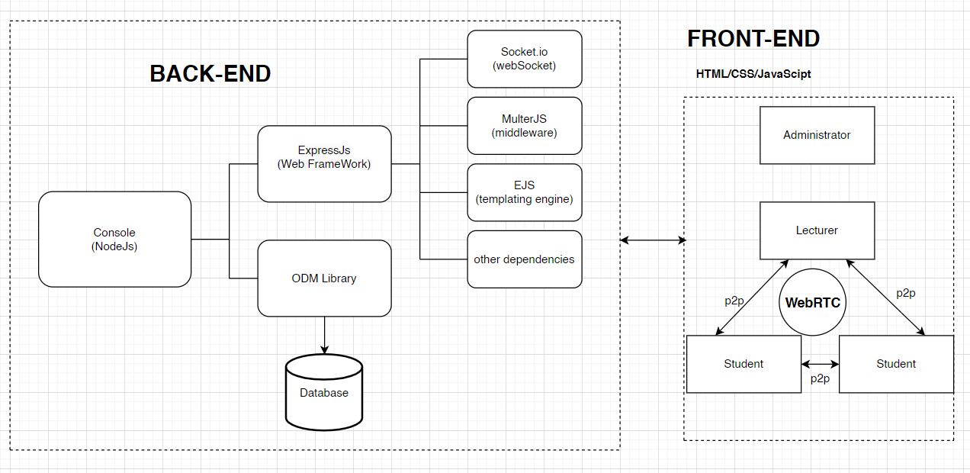
METHODOLOGY AND TECH STACK

Slide 6
WORKFLOW AND TIMELINE
Initiation and System Design
Development
&
Testing / QA
Deployment
February - March 2024
March - August 2024
September 2024

Slide 7
CONCLUSION
The interactive platform addresses challenges in universities, extending its positive impact to Ghana and other African countries.
The proposed platform, designed to encompass essential features such as resource access, assessment tools, quizzes, attendance tracking, and live lecture streams, is a strategic response to the pressing need for an advanced e-learning solution
It signifies a transformative step towards inclusive, high-quality education, contributing to the broader advancement of learning experiences and academic excellence.

